Slide 1
Attenborough-PEDIA
Darcy Bird
Violeta Calleja-Solanas
Ben Hosken
Lena Mangold
Sophia Schlosser
Thibault Prouteau

Slide 2
PROJECT OVERVIEW
Analyse and visualise the subtitles from a David Attenborough documentary series
Learn about Natural language processing and Visualisation
Identify change in language patterns across different series
Sophia

Slide 3
WHAT HAVE WE DONE
Processed 'Life of Birds' subtitles
NLP to extract nouns, adjectives, and bird names
Constructed network of terms
Performed a range of analysis on the graph/network
Thibeault

Slide 4
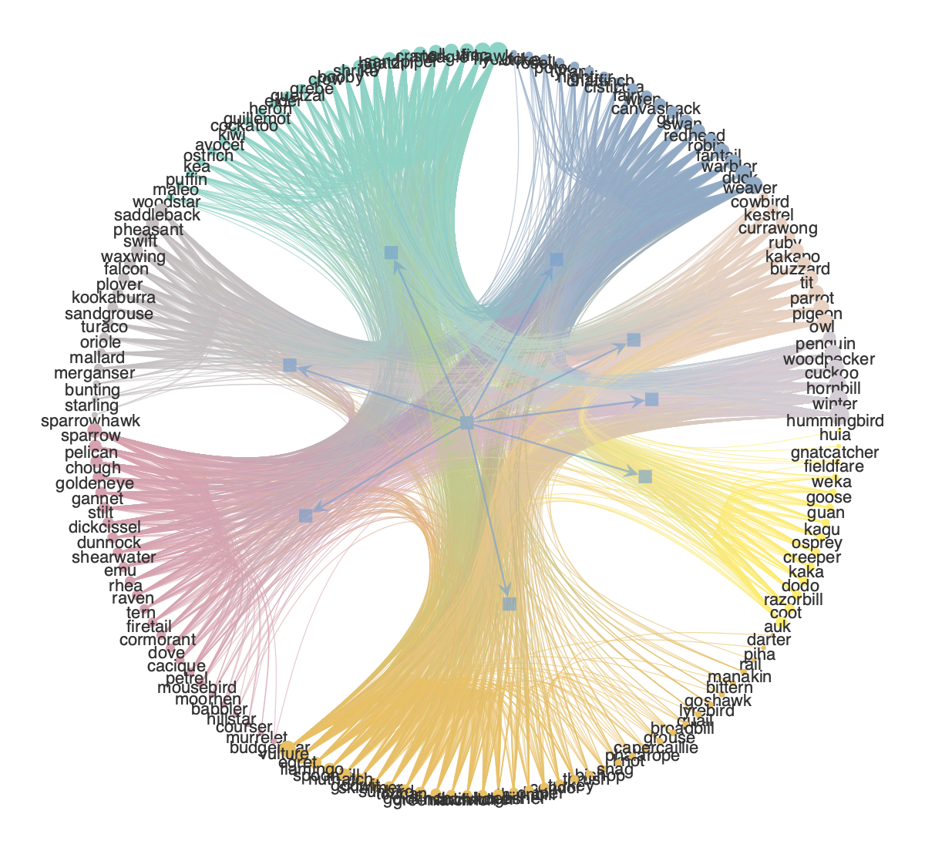
Bird network based on shared adjectives
Initial Findings
Lena

Slide 5
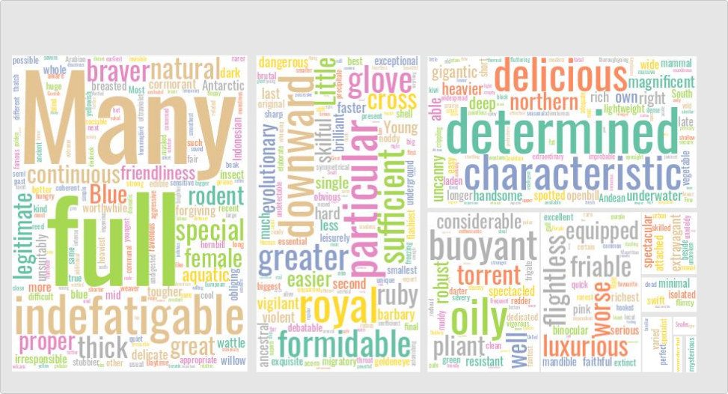
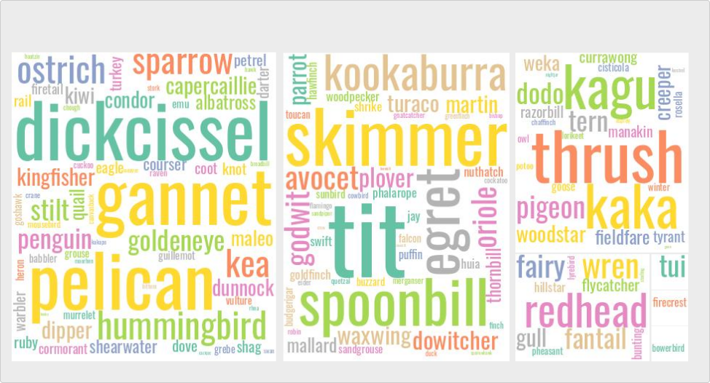
Adj-Bird Modules
Initial Findings
Violeta

Slide 6
INITIAL FINDINGS
Downloaded and processed 'Life of Birds' subtitles
NLP to extract nouns and adjectives
Identified bird names in subtitles
Loaded nouns and adjectives into network graph tools
Performed a range of analysis on the network

Slide 7
NEXT STEPS
Finalise analysis of Life of Birds
Run processing and analysis over other series
Topic modelling to identify change in focus over time (animals are cool -> save the animals!?!)
Darcy

